Slide 1
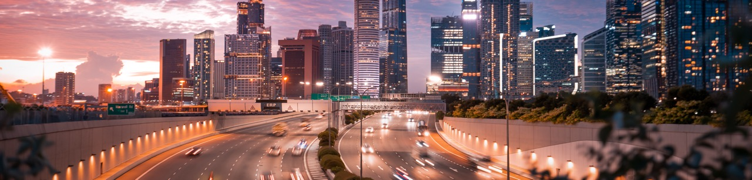

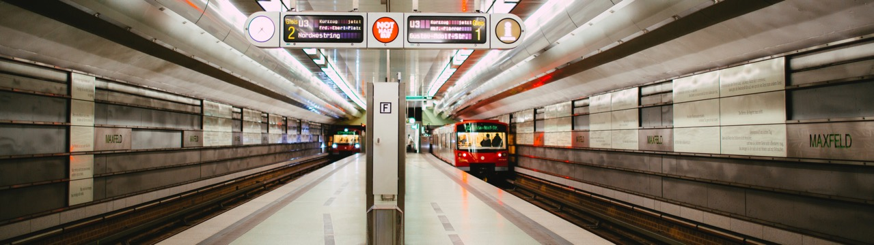
ABOVE OR BELOW GRADE
New Urban Infrastructure

Slide 2
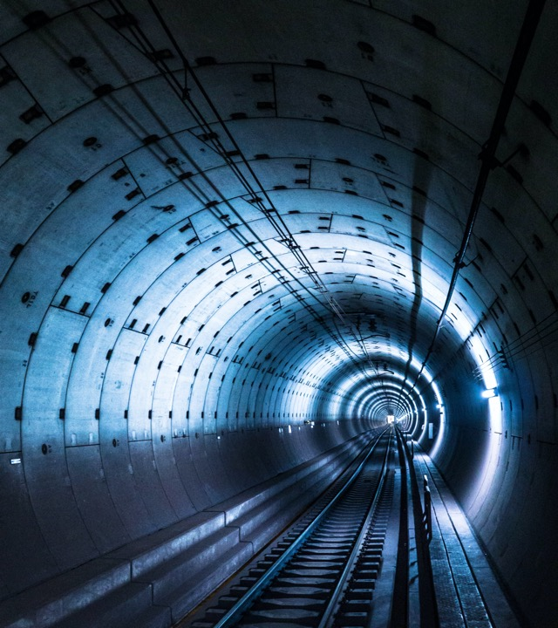
Uses
Benefits
Innovations
Infrastructure Choices
Underground solutions for city infrastructure; a general discussion.
Topics
Prepared by the Benefits of Going Underground Committee of the Underground Construction Association a Division of the Society of Mining Engineers.

Slide 3
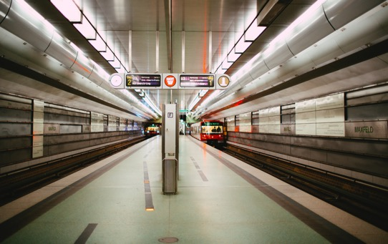
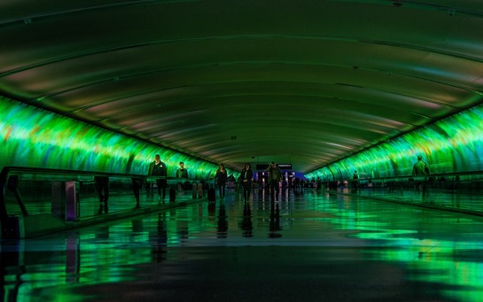
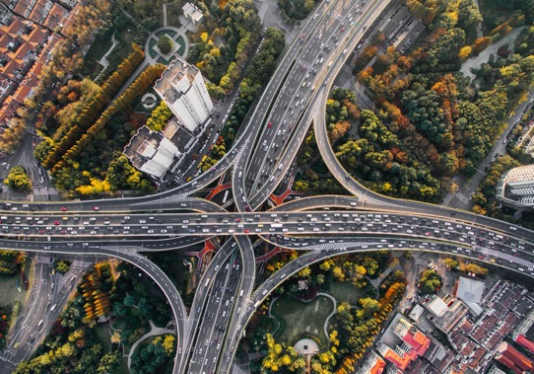
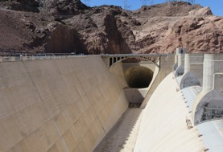
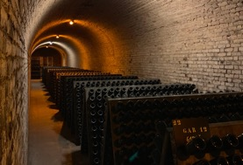
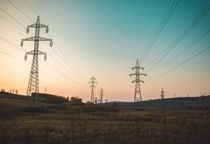
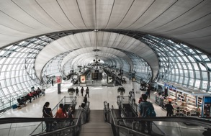

USES
1
Examples of surface infrastructure that can go underground.

Slide 4
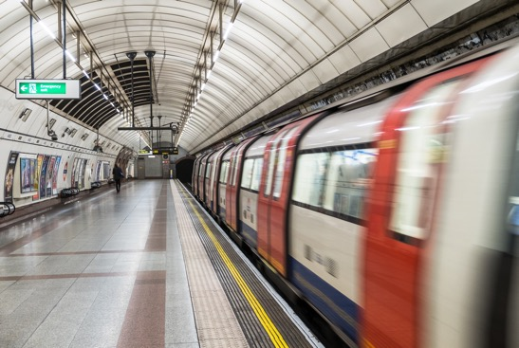

USES
RAPID TRANSIT DELIVERING:
Rider Comfort
Reliable Commutes
Year-round Operability
NEW URBAN INFRASTRUCTURE
Subway and Railroad Tunnels

Slide 5
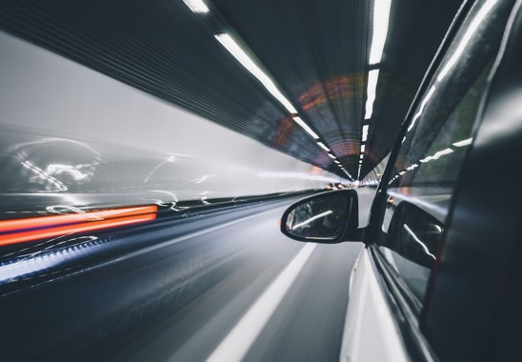
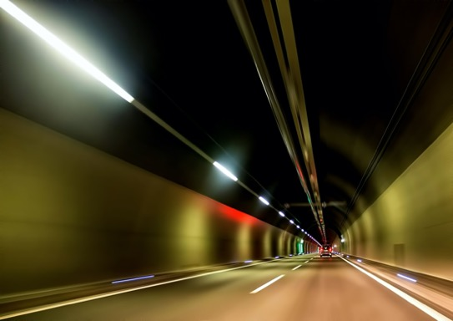
USES
TRAFFIC ROUTES PROVIDING:
Reduced neighborhood impact
Controlled service conditions
More efficient traffic flow
NEW URBAN INFRASTRUCTURE
Road Tunnels

Slide 6
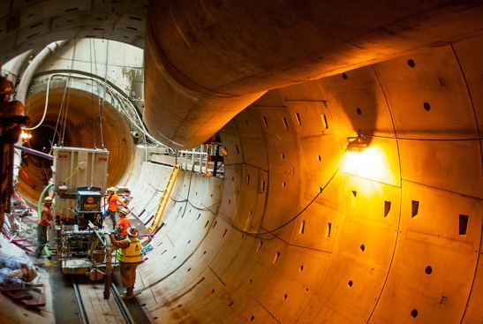
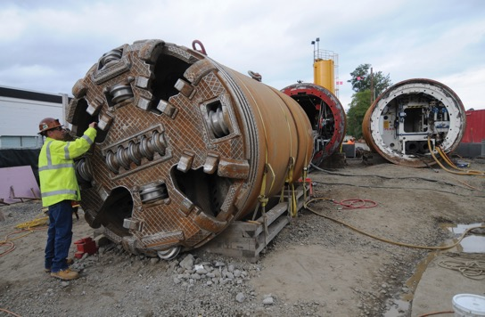
USES
PORTLAND OREGON
A new tunnel network keeps waterways clean.
NEW URBAN INFRASTRUCTURE
Sewer Tunnels

Slide 7
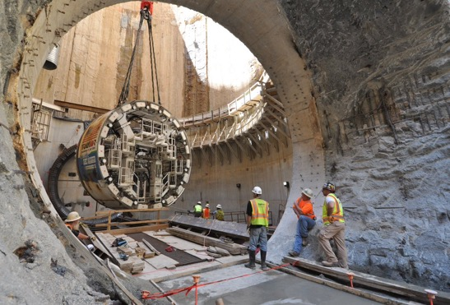
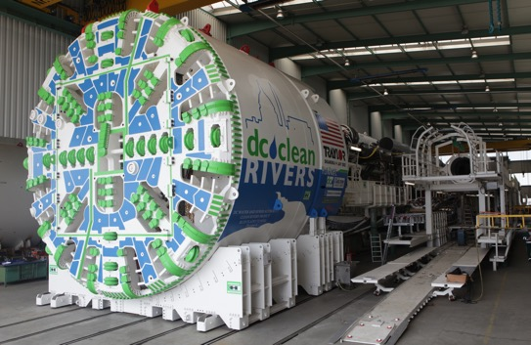
USES
WASHINGTON DC
Tunnels will control overflows and flooding.
NEW URBAN INFRASTRUCTURE
Combined Sewer Overflow Tunnels

Slide 8
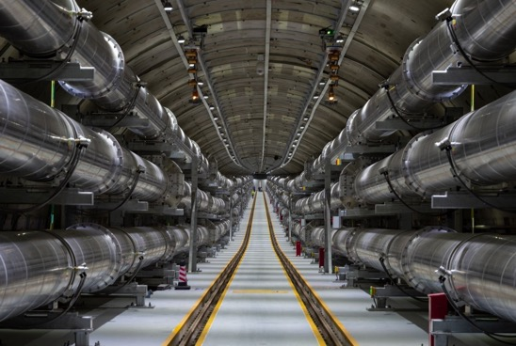
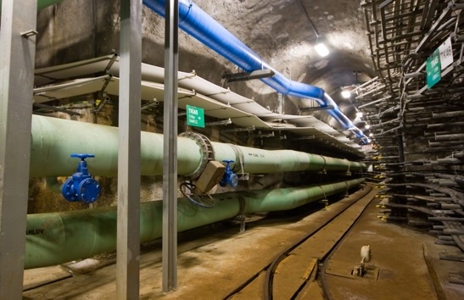
USES
Tunnels are resilient structures for hosting critical service networks for water, wastewater, gas, power communications, etc.
NEW URBAN INFRASTRUCTURE
Utility Tunnels
“Future generations of New Yorkers will have the clean and reliable supply of drinking water essential for our growing city.”
- Mayor Michael R. Bloomberg

Slide 9
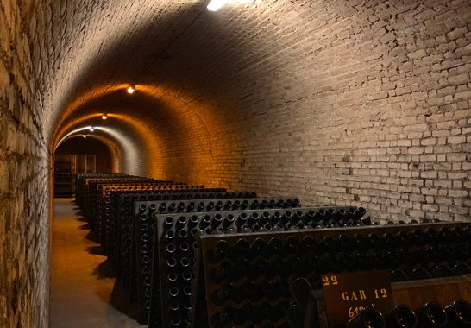
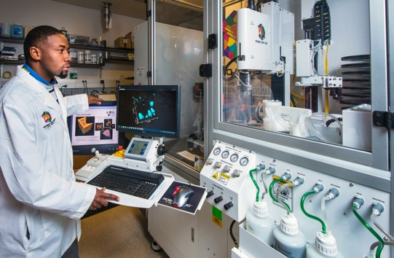
USES
Many types of facilities can be housed underground.
NEW URBAN INFRASTRUCTURE
Other Uses for Underground Space

Slide 10
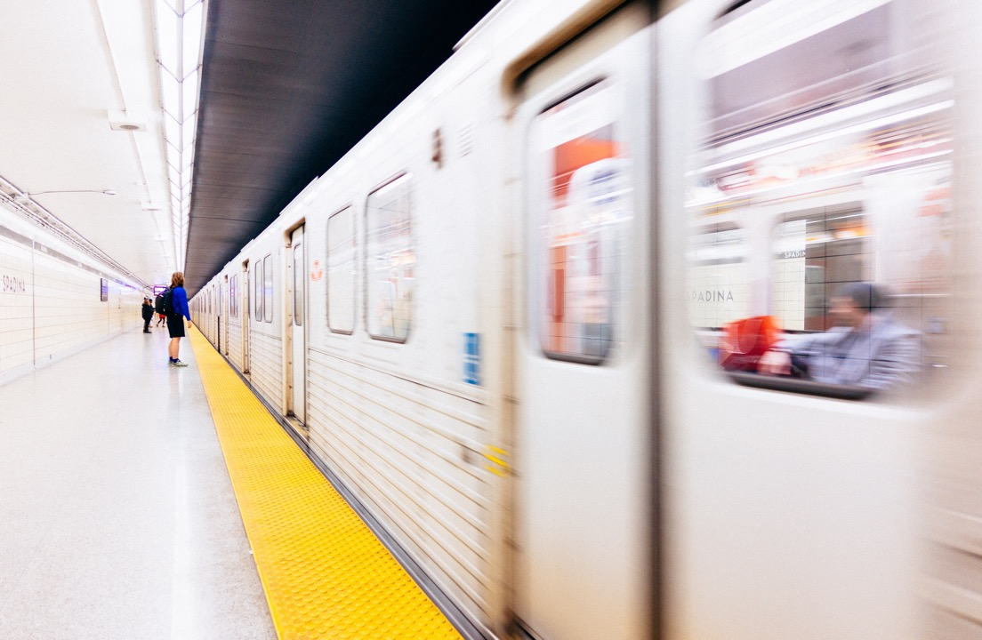
BENEFITS
2

Slide 11
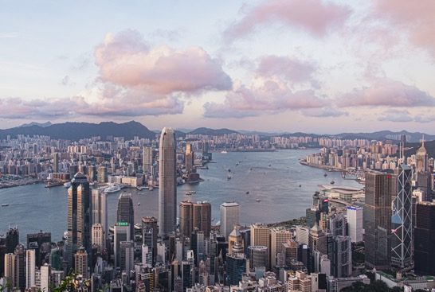
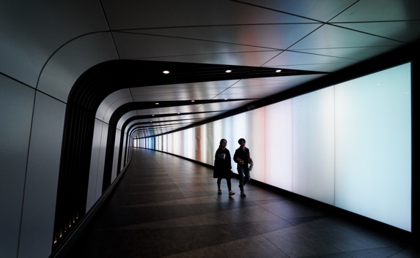
BENEFITS
Tunnels provide safe and efficient alignments under natural barriers and constructed areas.
Improving transit and network connections.
NEW URBAN INFRASTRUCTURE
Connecting Communities

Slide 12
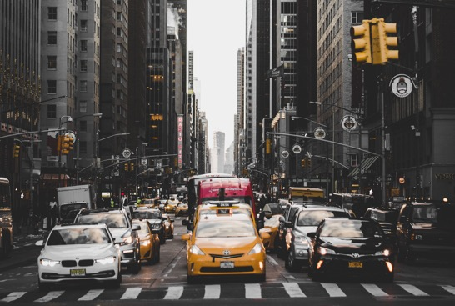
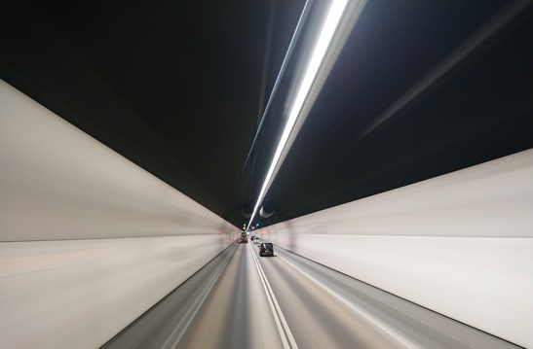
BENEFITS
Tunnels reduce city congestion and improve the urban environment for pedestrians and bikers.
Providing drivers with shorter, faster travel options. Improved circulation and added capacity.
NEW URBAN INFRASTRUCTURE
Relieving street- level gridlock

Slide 13
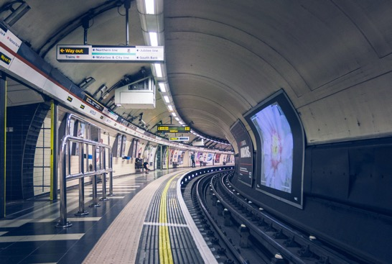
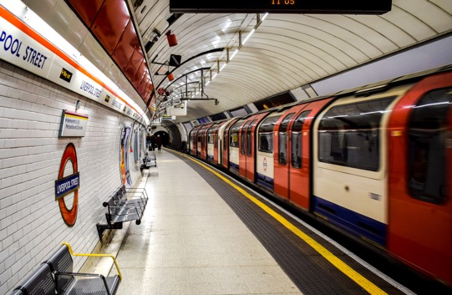
BENEFITS
Underground mass transit offers city travelers efficient commutes and inter-modal transfer.
Predictable transit times in a congested footprint. Cities with subways want more subway.
NEW URBAN INFRASTRUCTURE
Mobilizing the People

Slide 14
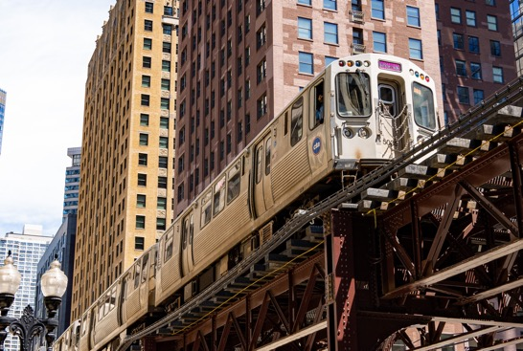
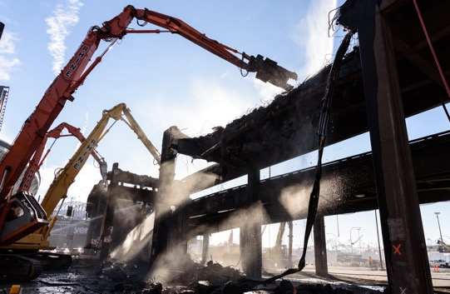
BENEFITS
Replacing aging infrastructure with an underground alternative can return surface space to the citizens.
Preserving the integrity of heritage structures.
NEW URBAN INFRASTRUCTURE
Revitalizing the City

Slide 15
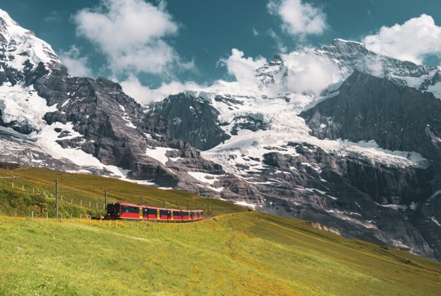
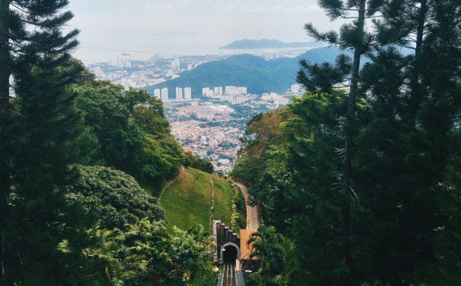
BENEFITS
Tunnels maintain green space and limit land takes.
Subsurface sites offer sustainable, energy efficiency models.
NEW URBAN INFRASTRUCTURE
Protecting the Environment

Slide 16
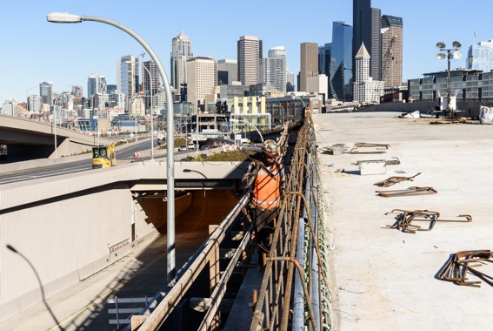
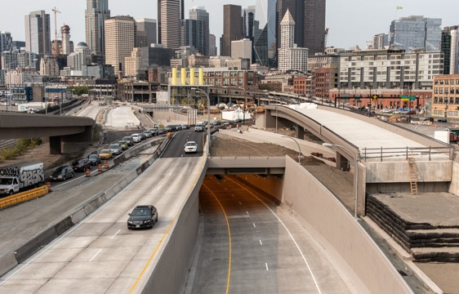
BENEFITS
Surface construction disrupts city business, damages adjoining structures and pollutes.
Tunnel work minimizes neighborhood impacts.
Maximum Tunneling = Minimum Disturbance
NEW URBAN INFRASTRUCTURE
Minimizing Construction Disruption

Slide 17
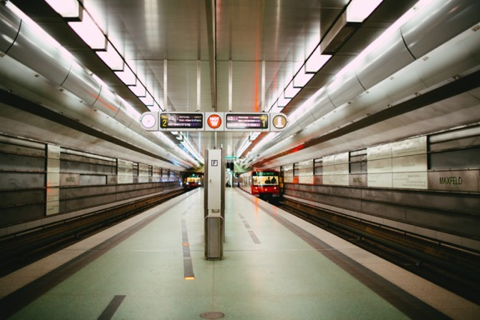
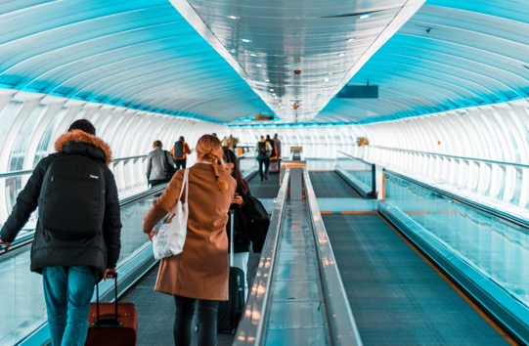
BENEFITS
Siting new infrastructure underground offers urban planners opportunities for high density development.
Delivering sustainable solutions that reduce sprawl and generate new residential and business revenue.
NEW URBAN INFRASTRUCTURE
Planning for a Better City

Slide 18
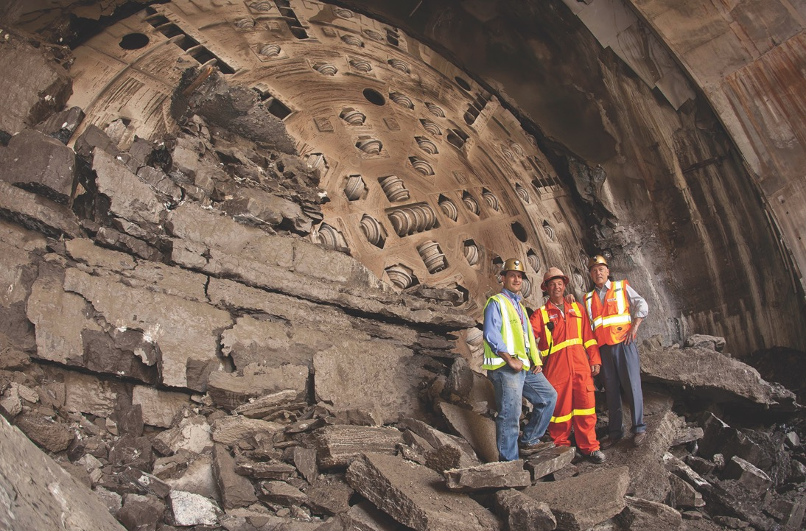
INNOVATIONS
3

Slide 19
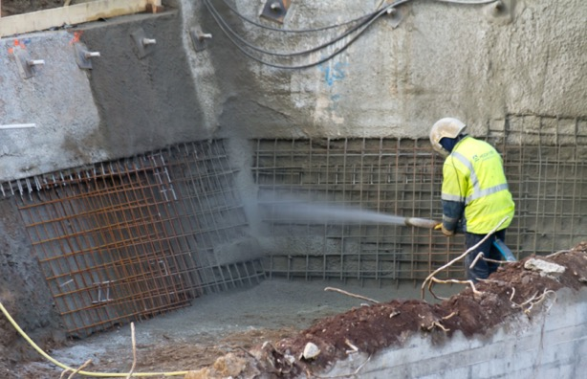
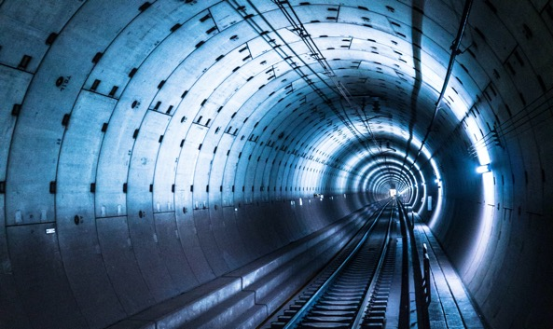
INNOVATIONS
3
Ground support systems reliably stabilize a wide range of adverse construction conditions.
Sprayed Concrete
NEW URBAN INFRASTRUCTURE
Ground Stabilization Methods
Pre-Cast Segmental Liners

Slide 20
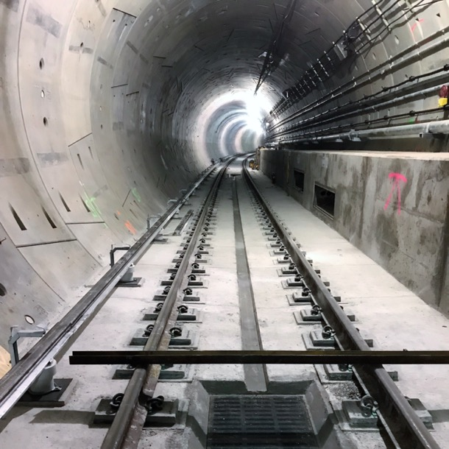
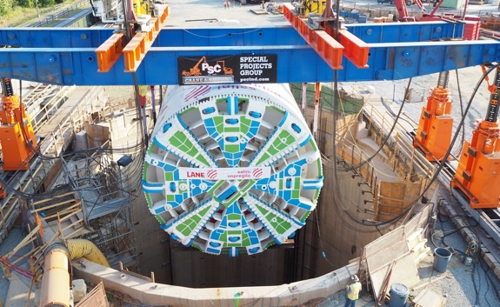
INNOVATIONS
3
Tunnel Boring Machines (TBM’s) and one-pass liners deliver dry tunnel subject to high external water pressures.
A tunnel is no longer a structure that “leaks.”
NEW URBAN INFRASTRUCTURE
Groundwater Control Methods

Slide 21
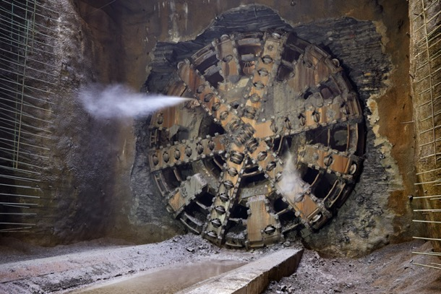
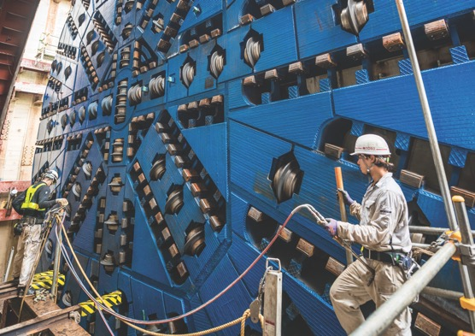
INNOVATIONS
3
TBM advance rates over one mile per month have been achieved under favorable ground conditions.
TBM technology is proven over a wide range of ground conditions and excavated diameters.
NEW URBAN INFRASTRUCTURE
TBM-System Performance

Slide 22
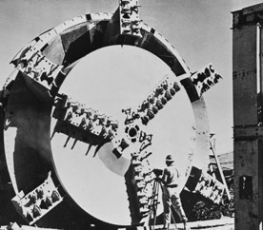
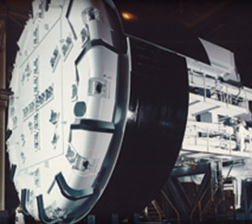
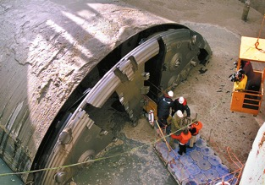
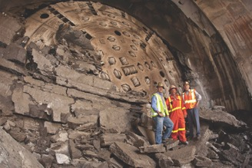
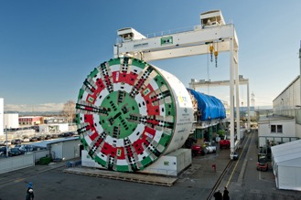
INNOVATIONS
3
NEW URBAN INFRASTRUCTURE
Examples of Large Diameter TBM Projects
Oahe Dam Tunnel / South Dakota
Tunnel & Reservoir Plan / Chicago
Elbe River 4th Road Tunnel
Niagra Pressure Tunnel Canada
Sparvo Road Tunnel, Italy

Slide 23
INNOVATIONS
3
Increments in Maximum TBM Diameter
Seattle
60
50
40
30
20
Maximum TBM Diameter, ft.
Sparvo
Niagara Falls
Elbe 4th
Chicago
Oahe
1950 1960 1970 1980 1990 2000 2010 2020

Slide 24
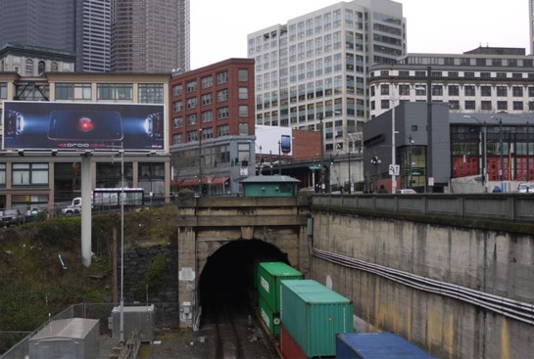
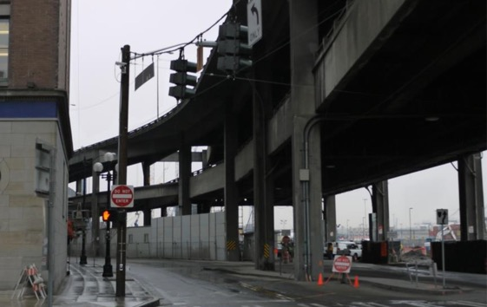
INNOVATIONS
3
TBM advance rates over one mile per month have been achieved under favorable ground conditions.
TBM technology is proven over a wide range of ground conditions and excavated diameters.
Built in 1904 / Still in regular service
NEW URBAN INFRASTRUCTURE
Underground Structures are Long-Lived
Built in 1945 / To be replaced by a tunnel

Slide 25

INNOVATIONS
3
“A Code of Practice for Risk Management of Tunnel Works.”
International Tunneling Insurance Group, 2nd Edition 2012
“Geotechnical Baseline Reports for Construction.”
American Society of Civil Engineers, 2007
“Recommended Contract Practices for Underground Construction.”
Society of Mining Engineers, 2008
Improved Contract Practices
New tunnel contract guidelines facilitate better management of underground risks; increasing confidence in the procurement process and construction outcome.

Slide 26

INFRASTRUCTURE CHOICES
4

Slide 27


INFRASTRUCTURE CHOICES
4
NEW URBAN INFRASTRUCTURE
The Community’s Choice
For Users:
More efficient, comfortable commutes.
For Residents:
Space returned to civic use.

Slide 28


INFRASTRUCTURE CHOICES
4
NEW URBAN INFRASTRUCTURE
The Operator’s Choice
Well-controlled operating environment.
Reliable, cost-competitive solutions to many contemporary urban infrastructure problems.

Slide 29

INFRASTRUCTURE CHOICES
4
NEW URBAN INFRASTRUCTURE
The Builder’s Choice
Methods are robust and outcomes predictable.
The number and size of tunnel contracts let in the US is increasing.
More contractors compete for more work.

Slide 30


INNOVATIONS
3
Underground alignments improve infrastructure operation and create more livable cityscapes.
Without a tunnel
NEW URBAN INFRASTRUCTURE
Underground:
A Win:Win Solution
With a tunnel

Slide 31

CITIES ARE RUNNING OUT OF SPACE
Time to Go Underground

Slide 32
Material Acknowledgements
Images thanks to:
Arup
CH2MHill
Herrenknecht GMBH
The Robbins Company
The Rose Kennedy Greenway Conservancy
District of Columbia Water and Sewer Authority

Slide 33

About UCA
UNDERGROUND CONSTRUCTION ASSOCIATION
UCA represents the underground construction industry; Owners, Contractors, Designers, Manufacturers, Suppliers, and others with an interest in underground construction.
UCA serves its members by advocating the responsible and cost-effective use of underground structures to improve the value and sustainability of public space.

